Slide 1
EECS 482
Lab 10: File Systems and Sockets

Slide 2
Administrivia
Project 4
Due 04/17
Today: 03/24

Slide 3
File Systems

Slide 4
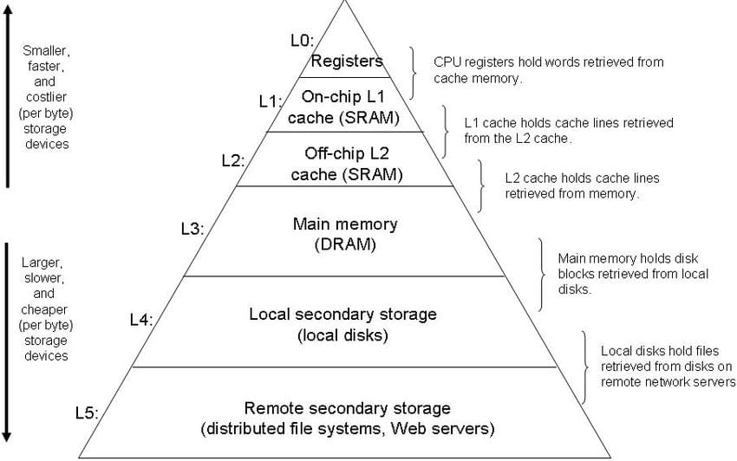
The hierarchy of data
Volatile
Persistent

Slide 5
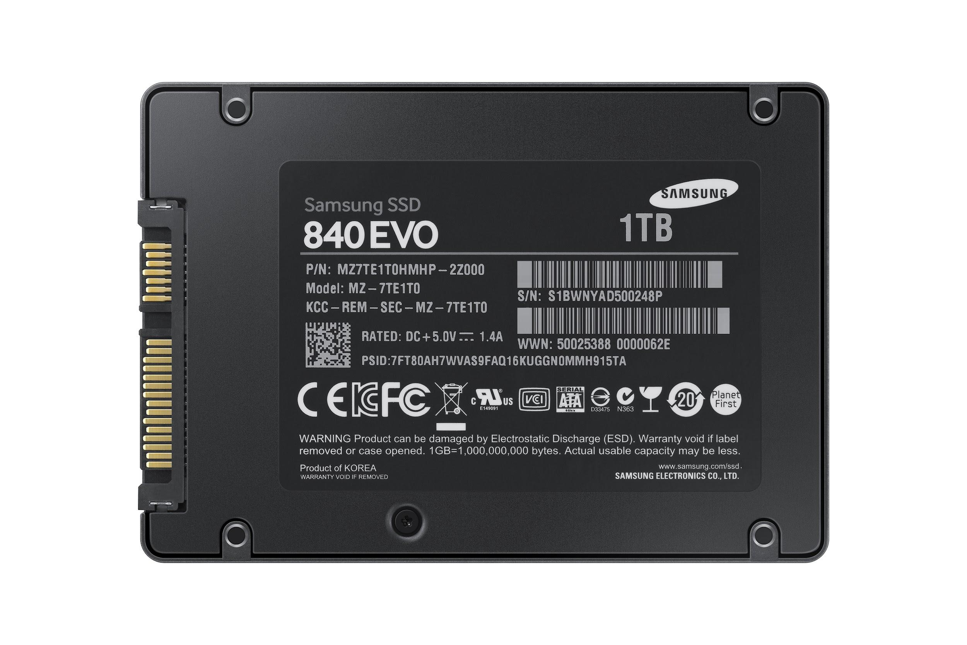
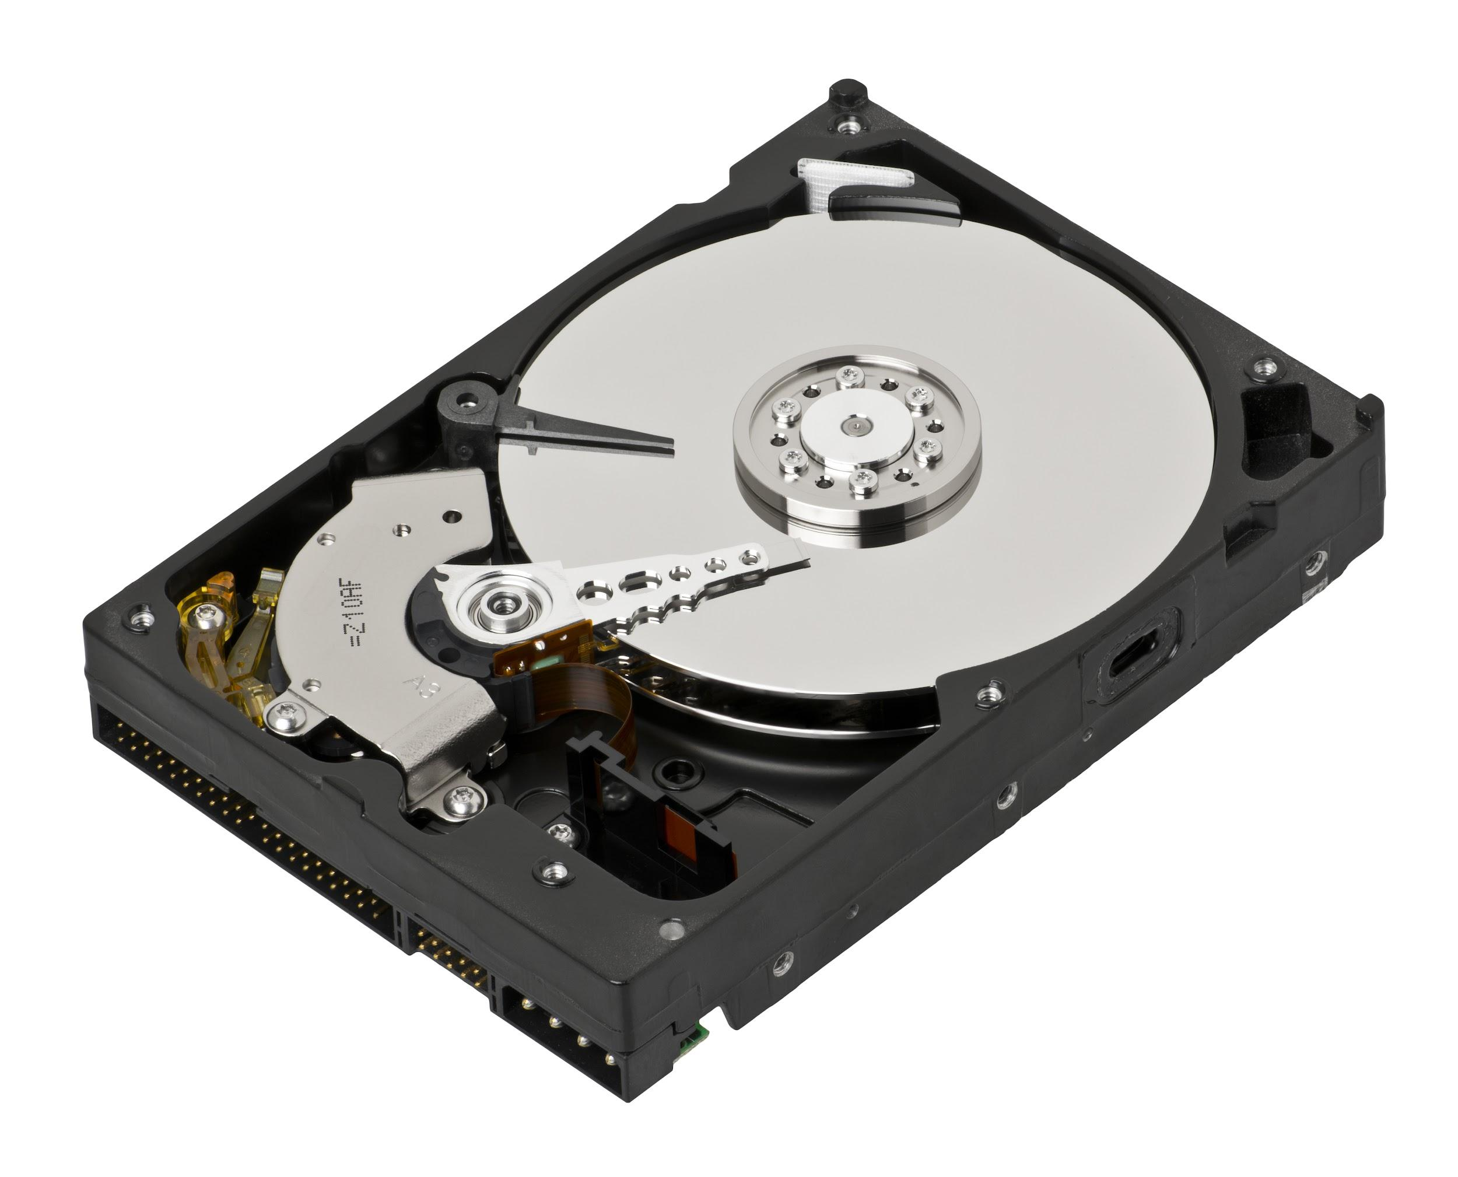
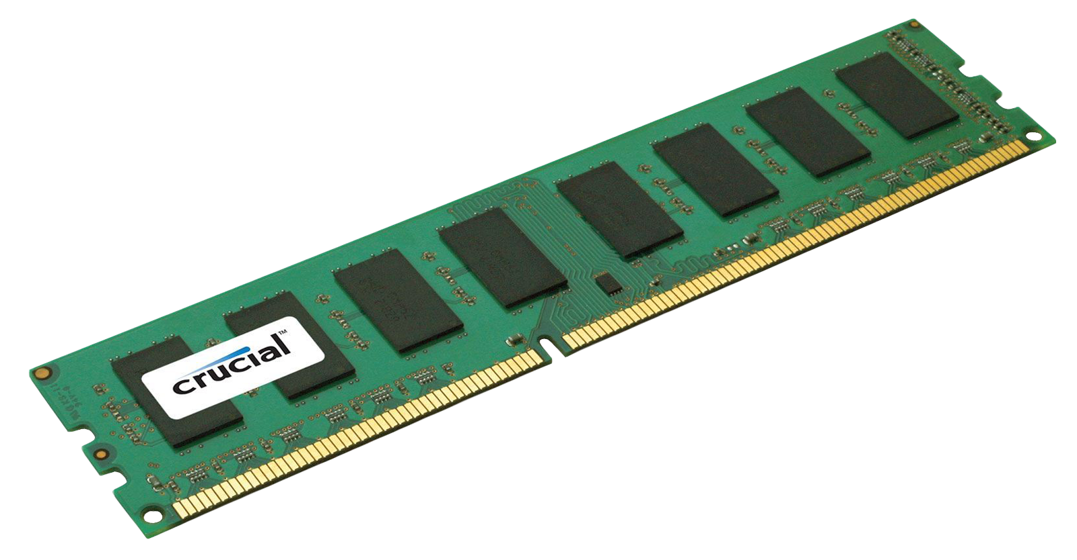
The hierarchy of data
DRAM
SSD
Hard Disk
$4.00 / GB
100 nanosecond access latency
$0.06 / GB
100 microseconds access latency
$0.02 / GB
1-10 millisecond access latency

Slide 6
Our end goal: provide a nice abstraction
How do we represent a hierarchy in a linear structure?
Hardware provides:
Array of bytes
Contiguous blocks
OS abstraction:
Discrete files
Hierarchical structure
Notes:
Blocks refer to the smallest unit of addressability. Writes to disk and reads from disk occur in block-sized chunks.
In other words, you cannot write single bytes to disk. You can only write or read an entire block. A block is usually something like 512 bytes or 4kb.

Slide 7
Representing a hierarchy with linear structure
name = 'P'
Node *left, *right;
You've done this before!
Hierarchy = EECS 280 tree
Linear structure = RAM
name = 'L'
Node *left, *right;
name = 'R'
Node *left, *right;
Pointers! (virtual addresses)
P
??
0x54
??
0x68
??
??
??
??
L
??
0x00
??
0x00
??
??
??
R
??
0x00
??
RAM
0x00
Address:
0x40
0x44
0x48
0x4C
0x50
0x54
0x58
0x5C
0x60
0x64
0x68
0x6C
0x70

Slide 8
Representing a hierarchy with linear structure
name = 'P'
Node *left, *right;
On disk, it's the same idea.
"Pointers" point to disk blocks.
name = 'L'
Node *left, *right;
name = 'R'
Node *left, *right;
Pointers! (disk block numbers)
P
??
5
??
6
??
??
??
??
L
??
0x00
??
0x00
??
??
??
R
??
0x00
??
Disk
0x00
Block:
4
5
0x50
5
0x58
0x5C
7
0x64
6
0x6C
0x70

Slide 9
How to represent a file?
Abstraction:
Named array of bytes
Implementation:
Collection of disk blocks
inode stores metadata
f.txt
f.txt inode
data: 2, 4, 0, ...
00110100
01011010
10001101
01001000
0101 f.txt 0011 0100
0 1 2 3 4 5

Slide 10
How to represent a directory?
Abstraction:
Named collection of files
Implementation:
Special file
Map from name to inode
dir
dir inode
data: 5
f.txt: 1
b.txt: 7
f.txt
b.txt
0101 f.txt 0011 0100
0 1 2 3 4 5

Slide 11
A full look at a file system
/
dir
/dir/
inode
/
inode
bar
/dir/
direntries
bar
baz
baz
/
direntries
dir
foo
fax
foo
/foo
inode
fax
/dir/bar
inode
/fax
inode
/dir/baz
inode
11001111
10101011
10100101
11101110
00000001
01000111
00101100
11101010
Notes:
Every box here would take up a single disk block.

Slide 12
Getting Started with Project 4

Slide 13
Project 4 is Two Parts
File Server
read /foo/bar
delete /tmp
create /my/fizz

Slide 14
Project 4 is Two Parts
Parsing / Requests
socket code
parsing requests
validating requests
sending responses
File Server

Slide 15
Project 4 is Two Parts
Parsing / Requests
socket code
parsing requests
validating requests
sending responses
File System
disk_readblock/writeblock
fs tree traversal
validating requests
hand-over-hand locking
crash consistency

Slide 16
**Separate these two parts**
Parsing / Requests
socket code
parsing requests
validating requests
sending responses
File System
disk_readblock/writeblock
fs tree traversal
validating requests
hand-over-hand locking
crash consistency

Slide 17
**Separate these two parts**
start here
Parsing / Requests
socket code
parsing requests
validating requests
sending responses
File System
disk_readblock/writeblock
fs tree traversal
validating requests
hand-over-hand locking
crash consistency

Slide 18
Parsing: the most important thing to remember
Know the difference between a C-string and a bunch of bytes.
Use the right function for the job.
C-strings
strlen()
strcpy()
std::string(buf)
Bucket-o-bytes
sizeof()^{(*)}
memcpy()
std::string(buf, len)

Slide 19
Other parsing tips
The request header is null-terminated. The body is not.
This changes how you do your recv() calls.
Make use of strings and stringstreams.
Don’t worry about raw performance if it jeopardizes possible correctness or readability.
Unit test your parsing code to catch bugs.
i.e., call your functions directly in some C++ program
Note: there is only one correct input format, but many incorrect
It is easier to check if something is correct than if it is incorrect

Slide 20
Sockets

Slide 21
Context: networked file systems
File Server
read /foo/bar
delete /tmp
create /my/fizz

Slide 22
Sockets: inter-process communication channels
Two-way byte stream between two processes or machines
send()
recv()
01110100
10001100

Slide 23
POSIX socket interface
int socket(AF_INET, SOCK_STREAM, 0);
int send (sockfd, buffer, size, flags);
int recv (sockfd, buffer, size, flags);
int bind (sockfd, addr);
int listen (sockfd, queue_size);
int accept (sockfd, 0, 0);
int connect(sockfd, addr);
int close (sockfd);

Slide 24
Quick note: POSIX-style APIs
We don’t get to do:
Socket sock = Socket();
sock.send(...);
sock.recv(...);
...

Slide 25
Quick note: POSIX-style APIs
Typically, in C, it looks like this:
socket_t* sock = socket();
send(sock, ...);
recv(sock, ...);
...

Slide 26
Quick note: POSIX-style APIs
Actually, these OS apis use file descriptors, not pointers:
// Integer “handle” to os-internal socket object
int sockfd = socket();
send(sockfd, ...);
recv(sockfd, ...);
...

Slide 27
Sending and receiving with sockets
/* Send up to len bytes to peer from buffer.
* Returns number of bytes sent, or < 0 if error. */
int send(int sockfd, void *buffer, size_t len, int flags);
/* Receive up to len bytes from peer into buffer.
* Returns number of bytes received, or < 0 if error. */
int recv(int sockfd, void *buffer, size_t len, int flags);

Slide 28
Sending and receiving with sockets
/* Returns number of bytes sent, or < 0 if error. */
int send(int sockfd, void *buffer, size_t len, int flags);
// Assume we already set up a socket and obtained sockfd
std::string message = “Hello, peer!”;
size_t message_len = message.length()+1; // null terminator
size_t bytes_sent = 0;
do {
bytes_sent += send(sockfd, message.c_str() + bytes_sent,
message_len - bytes_sent, 0);
} while (bytes_sent < message_len);

Slide 29
Sending and receiving with sockets
/* Returns number of bytes received, or < 0 if error. */
int recv(int sockfd, void *buffer, size_t len, int flags);
// Assume we already set up a socket and obtained sockfd
std::string message;
char buf[64];
do { // You may not get all of the data at once!
int bytes_recvd = recv(sockfd, buf, sizeof(buf), 0);
message += std::string(buf, bytes_recvd);
} while (bytes_recvd > 0);
Notes:
Using std::string::append is probably better, but explicitly constructing a new std::string object is more explicit for the purpose of teaching

Slide 30
Sending and receiving with sockets
/* Returns number of bytes received, or < 0 if error. */
int recv(int sockfd, void *buffer, size_t len, int flags);
// Assume we already set up a socket and obtained sockfd
std::string message;
char buf[64];
do {
int bytes_recvd = recv(sockfd, buf, sizeof(buf), 0);
message += std::string(buf, bytes_recvd);
} while (bytes_recvd > 0);
Note: recv() does not return 0 until client calls close()
Notes:
The only way for a receiver to know if it has received all the data it needs when the client keeps the connection open is to have some sort of protocol or request format

Slide 31
Sending and receiving with sockets
/* Returns number of bytes received, or < 0 if error. */
int recv(int sockfd, void *buffer, size_t len, int flags);
// Assume we already set up a socket and obtained sockfd
std::string message;
char buf[64];
do {
int bytes_recvd = recv(sockfd, buf, sizeof(buf), 0);
message += std::string(buf, bytes_recvd);
} while (bytes_recvd > 0);
You will need a different stopping condition for your P4 parsing code
Notes:
The only way for a receiver to know if it has received all the data it needs when the client keeps the connection open is to have some sort of protocol or request format

Slide 32
Sending and receiving with sockets (the modern C++ way)
/* Returns number of bytes received, or < 0 if error. */
int recv(int sockfd, void *buffer, size_t len, int flags);
// Assume we already set up a socket and obtained sockfd
std::string message;
std::array<char,64> buf{};
do {
int recvd = recv(sockfd, buf.data(), buf.size(), 0);
message.append(buf.data(), recvd);
} while (recvd > 0);

Slide 33
Sending and receiving with sockets
/* Returns number of bytes received, or < 0 if error. */
int recv(int sockfd, void *buffer, size_t len, int flags);
// Assume we already set up a socket and obtained sockfd
/* Handy recv flag: MSG_WAITALL
* Causes recv to block until exactly len bytes recv’d. */
char UMID[8]; // Your UMID is always 8 digits
recv(sockfd, UMID, 8, MSG_WAITALL);
// Be careful: this only works if the sender sends exactly 8 bytes

Slide 34
Sending and receiving with sockets (the modern C++ way)
/* Returns number of bytes received, or < 0 if error. */
int recv(int sockfd, void *buffer, size_t len, int flags);
// Assume we already set up a socket and obtained sockfd
/* Handy recv flag: MSG_WAITALL
* Causes recv to block until exactly len bytes recv’d. */
std::array<char,8> UMID{}; // Your UMID is always 8 digits
recv(sockfd, UMID.data(), 8, MSG_WAITALL);
// Be careful: this only works if the sender sends exactly 8 bytes

Slide 35
How to set up the connection?
Anybody wanna talk?
Anybody wanna talk?
...
Notes:
This isn’t gonna work.

Slide 36
How to set up the connection?
One endpoint has to initiate the connection.
Anybody wanna talk?
I wanna talk!
connect()
listen()
accept()
1010010110
send()/recv()

Slide 37
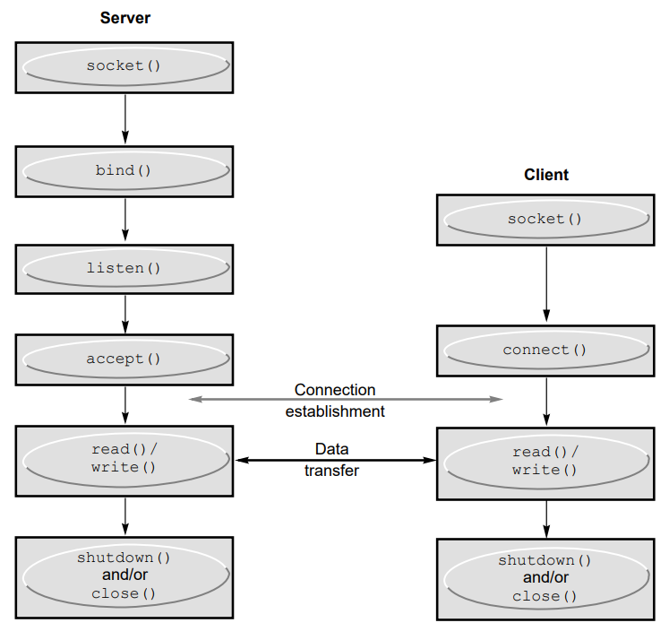
Full socket lifecycle
Somewhat analogous to setting up a phone conversion.
Notes:
Feel free to skim/skip the following slides. Students don't need to know how each and every socket syscall works because the starter code already works out of the box

Slide 38
Full socket lifecycle
Somewhat analogous to setting up a phone conversion.
In project 4, libfs_client.o implements this functionality
Notes:
Feel free to skim/skip the following slides. Students don't need to know how each and every socket syscall works because the starter code already works out of the box

Slide 39

socket(AF_INET, SOCK_STREAM, 0)
Creates a listener socket.
Kind of like buying a phone.

Slide 40
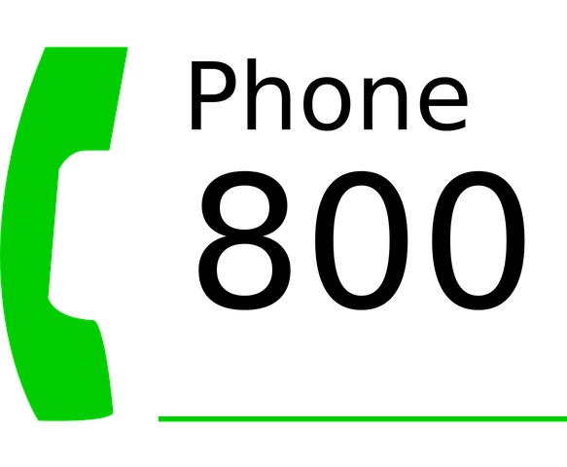
bind(sock, addr, sizeof(addr))
Associates our socket with a port.
Like getting a phone number.
addr is a struct full of parameters that specify what to bind to.
Port number: addr.sin_port
If the port is 0, then the OS chooses a port for you.

Slide 41

listen(sock, backlog)
Begin listening for connections.
Like plugging the phone in.
Incoming requests wait in a queue of size backlog.

Slide 42

conn = accept(sock, 0, 0)
Take a request out of the queue and return a new connection socket.
Like answering the phone.
Blocks if no pending connections.
Like waiting for the phone to ring.

Slide 43
conn = accept(sock, 0, 0)
Take a request out of the queue and return a new connection socket.
This new socket is what you call send() and recv() on.

Slide 44

send()/recv()
Connection is now established.
May now send() and recv().

Slide 45
close(sock)
Closes this end of the connection, or closes the listening socket.
Like hanging up.

Slide 46
Client side
Being a client is much simpler.
Like calling somebody.

Slide 47
socket(AF_INET, SOCK_STREAM, 0)
Creates a client socket.
Like buying a cell phone.
Note: no different than creating a listener socket.
All sockets are the same until either listen() or connect() is called.

Slide 48

connect(sock, addr, sizeof(addr))
Connect to a remote listener.
Like calling somebody.
addr contains server address and port.
Does not return a new connection fd.
Returns 0 on success, -1 on failure.

Slide 49
Note: byte order
Different machines use different byte orders for numbers.
int val = 0x0A0B0C0D;
/* little-endian: 0D 0C 0B 0A */
/* big-endian: 0A 0B 0C 0D */
There is one single standard network byte order.
Use ntohs() / htons() to convert to/from network byte order
You must do this when sending numeric types over a network.
https://www.gnu.org/software/libc/manual/html_node/Byte-Order.html

Slide 50
Lab Questions

Slide 51
Big file
A big file /bigfile that is 4 blocks in size is stored in the file system.
Draw out how /bigfile is laid out on disk. Include all inodes and data blocks required to store the file. Assume there are no other files.

Slide 52
Big file
A user makes a read request for /bigfile at offset 0.
How many disk accesses are required to process the request?

Slide 53
Creating a directory
If we wanted to add a new directory, /foo, how many new disk blocks do we need to allocate?
Update your diagram with the new disk blocks.

Slide 54
Creating a file
If we wanted to add a new file, /foo/bar, how many new disk blocks do we need to allocate?
Update your diagram with the new disk blocks.

Slide 55
Best case / worst case
What is the minimum and maximum number of disk blocks that must be brought into memory in order to read the first block of the file /etc/passwd?
Assume each file/directory can contain FS_MAXFILEBLOCKS data blocks.

Slide 56
Socket programming lab exercise
Write a simple client and server, where the client sends a string to the server, the server outputs the string using cout, and then sends some acknowledgement response back to the client.

Slide 57
Lab Exercise
Git Repo

